Slide 1



Nikhil Mishra
Rishabh Nahar

Slide 2


Introduction
In today's rapidly evolving healthcare landscape, efficient hospital logistics is pivotal for ensuring
seamless operations and optimal productivity. An online hospital logistics system serves as a
comprehensive solution that streamlines various administrative tasks and optimizes resource
allocation. This system provides effective tools and features for managing hospital transport for staff
and patients, along with overseeing the inventory and allocation of medical equipment.
Essential components of the system:
● Hospital Ambulance Management
● Medical Instrument Inventory Management
Furthermore, our web application “WeCare” will be implemented with cloud services which will
include chatbot and other services as the project progresses.

Slide 3


PROBLEM STATEMENT
Inefficient Hospital Transport Management:
Current hospital transport scheduling and management processes lack optimization.
Lack of a centralized system results in delays and confusion in transporting both staff and patients.
Inadequate Tracking of Medical Equipment Inventory:
The existing system lacks effective tracking and management of medical equipment inventory.
The absence of real-time monitoring may lead to shortages or difficulties in locating essential equipment.
Insufficient Real-time Analytics:
Current analytics tools lack robustness, hindering effective tracking of key performance indicators and resource utilization.
Administrators face challenges in making data-driven decisions due to a lack of insightful reports.

Slide 4

Exisiting Systems
01
Saamipya:
Saamipya, though reputable, may have room for improvement, particularly in terms of stock availability.
The website, while serving healthcare professionals effectively, could enhance user experience by addressing minimal stock levels.
02
Liberent:
Liberent is a rental platform that offers a diverse range of lifestyle products for short-term use.
Specializing in providing cameras, gaming consoles, and other gadgets, Liberent allows users to access premium equipment without the need for ownership.
03
Rentickle:
Rentickle focuses on offering furniture and home appliances for rent, catering to the residential and commercial segments.
The platform provides curated packages for different needs, such as home furniture, office furniture, and appliances.

Slide 5

PROPOSED SYSTEM
The "WeCare" web application is designed as a comprehensive solution to revolutionise hospital logistics in the dynamic healthcare landscape.
It addresses key challenges, such as streamlining hospital transport management and providing hygienic medical instruments. The system enhances medical equipment inventory management by implementing automated alerts, and dynamic allocation based on real-time demand, ensuring availability and adaptability within healthcare facilities.
Additionally, the proposed system introduces a robust billing and invoicing module, real-time analytics tools, and heightened security measures to ensure patient data protection and regulatory compliance.
Furthermore, the user experience is enhanced with streamlined admin functions, cloud service integration for accessibility, and the addition of a chatbot for user support.
This forward-looking approach incorporates emerging technologies, and as the "WeCare" project progresses, continuous updates will be implemented to keep the online hospital logistics system adaptive, efficient, and aligned with the evolving needs of healthcare delivery.

Slide 6
Functional Requirements
Requirement ID | Requirement Name | Description
FR1 | Dashboard Display | The system should provide a comprehensive dashboard displaying all details and updates related to medical equipment and ambulances.
FR2 | Hospital Info | Information about hospital partners should be available, including details about the hospitals utilizing the services.
FR3 | Detailed Analysis | The system should generate detailed reports on medical instruments and ambulance stocks, feedback, etc., represented through various charts for easy analysis.
FR4 | Rating System | Users should be able to provide feedback by rating the services. The system should support a rating system for user evaluations.
FR5 | Security | Strong security protocols should be implemented to protect user data and prevent unauthorized access to sensitive information.

Slide 7

Functional Requirements
Requirement ID | Requirement Name | Description
FR6 | Notifications | The system should send out notifications whenever a service, such as an ambulance booking, is made, ensuring timely communication.
FR7 | User Registration | Hospital staff and other users should be able to register and log in to the system, allowing them to access relevant functionalities.
FR8 | Emergency Transport Management | Hospitals should have the ability to book ambulance transportation services efficiently through the system.
FR9 | Hospital Instrument Management | Hospitals should be able to order hygienic medical instruments through the system, streamlining the management of medical equipment.
C_FR10 | Admin Operations | Admin functionalities should include managing all details, as well as performing operations such as editing, adding, approving, and overseeing the system

Slide 8




Non Functional Requirements
Requirement ID | Requirement Name | Description
Security | Data Security | Ensure the security of sensitive data, especially patient information and financial transactions.
 | Access Control | Implement strong access control mechanisms to protect system integrity.
Performance | Real-time Responsiveness | The system should respond in real-time to ensure efficient logistics handling.
 | Scalability | It should be scalable to accommodate increasing data and user loads.
Usability | User-Friendly Interface | The user interface should be intuitive and user-friendly for all user types.
 | Training Requirements | Minimize training requirements for users to effectively use the system.
Reliability | System Uptime | Ensure high system availability to minimize disruptions in hospital logistics operations.
Integration | Third-party Integration | Support integration with external systems, such as accounting software.

Slide 9
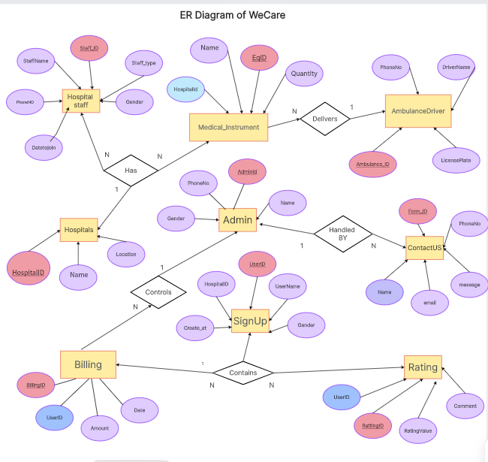


Slide 10

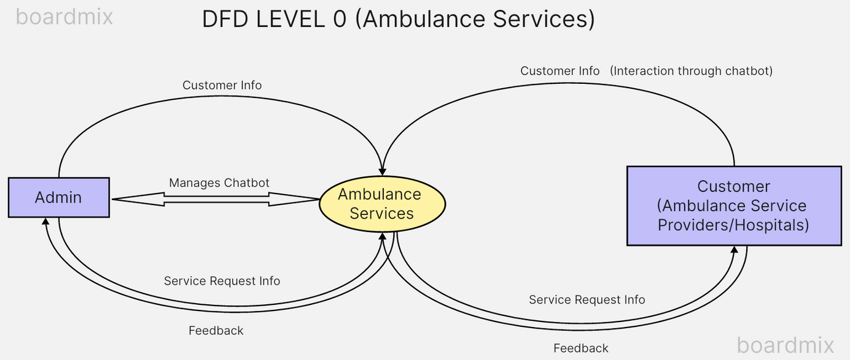
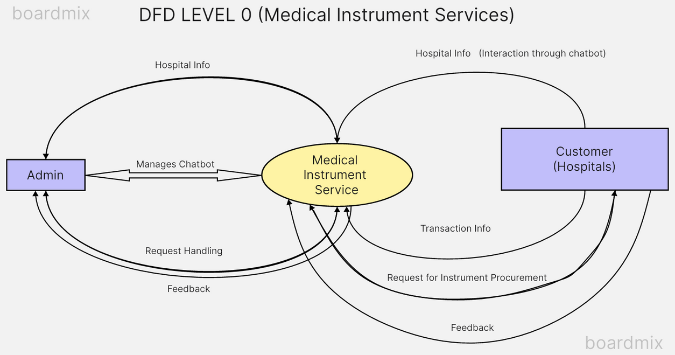
DFD DIAGRAM LEVEL 0

Slide 11
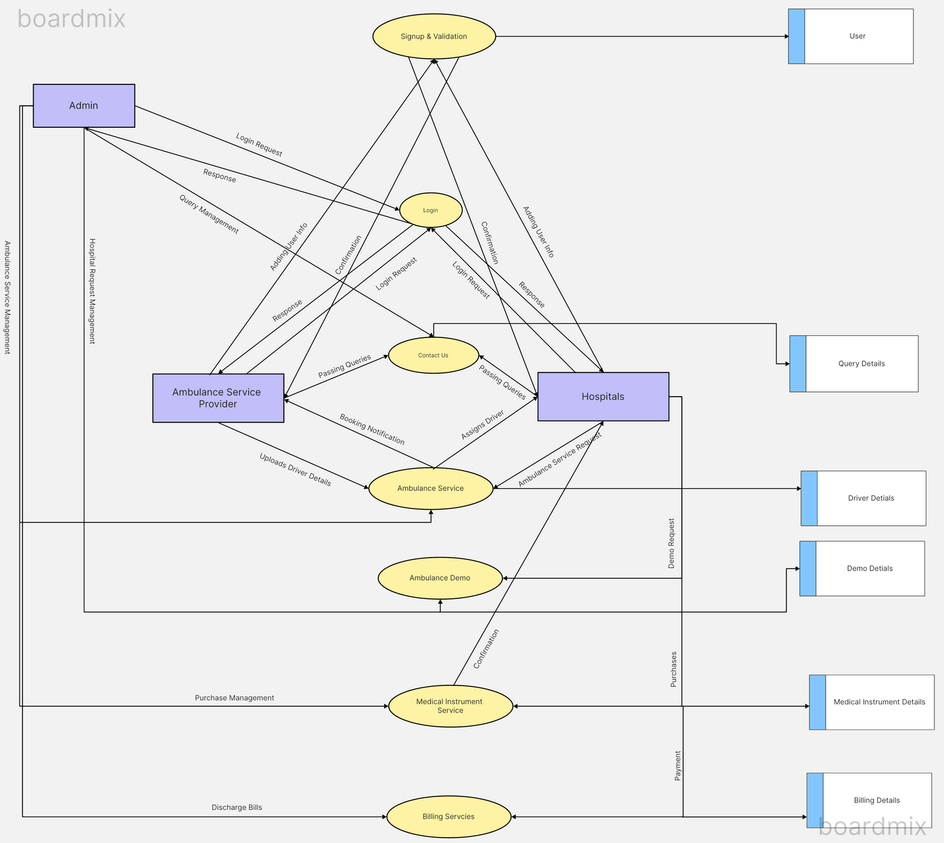
DFD DIAGRAM LEVEL 1

Slide 12

Thank You

